Slide 1
SCHOOL OF ENGINEERING, ELECTRICAL AND ELECTRONIC ENGINEERING
NETWORKS 4_ Week D_
Ronald van Buuren
May 2023

Slide 2
net4 program by week
1st order RC networks – discharging – DC source
1st order RC networks – charging –DC source
RL networks – Steady-state DC
RL networks – Switched DC source
RC & RL networks – complementary solution
<spare week>
Sample Exam

Slide 3
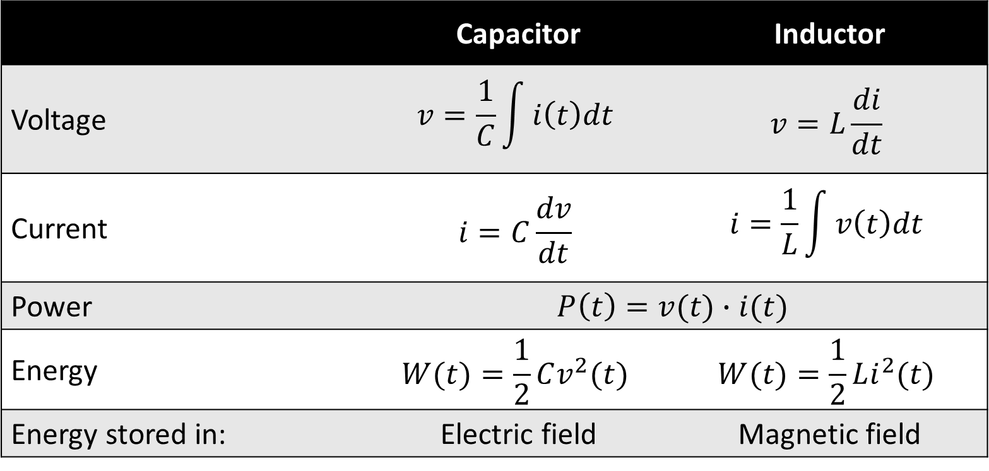
Capacitor & inductor relations
 | Capacitor | Inductor
Voltage | $$v=\frac{1}{C}\int{i\left(t\right)dt}$$ | $$v=L\frac{di}{dt}$$
Current | $$i=C\frac{dv}{dt}$$ | $$i=\frac{1}{L}\int{v\left(t\right)dt}$$
Power | $$P\left(t\right)=v(t)∙i(t)$$
Energy | $$W(t)=\frac{1}{2}Cv^{2}(t)$$ | $$W(t)=\frac{1}{2}Li^{2}(t)$$
Energy stored in: | Electric field | Magnetic field

Slide 4
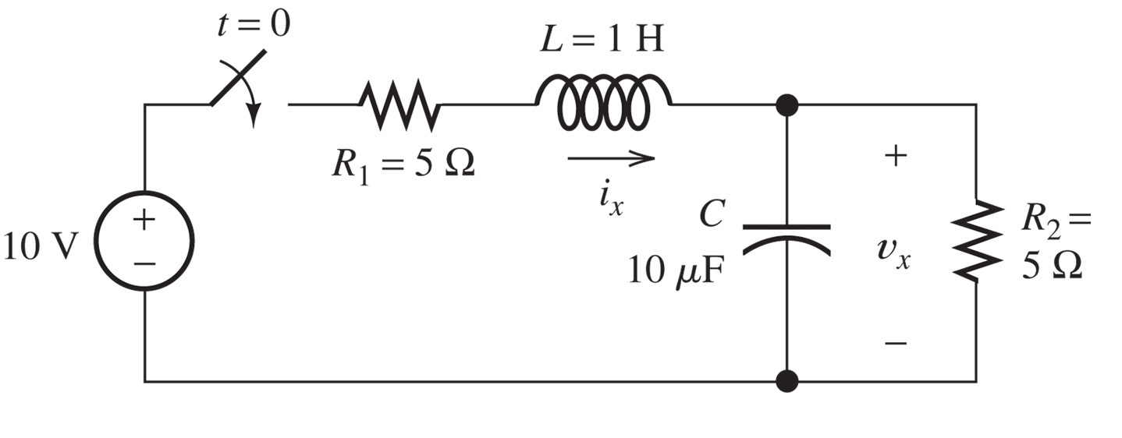

week c: DC Steady State
At $t=0$ we close the switch
Hoe groot zijn i_{x} en v_{x} op $t=∞$?

Slide 5
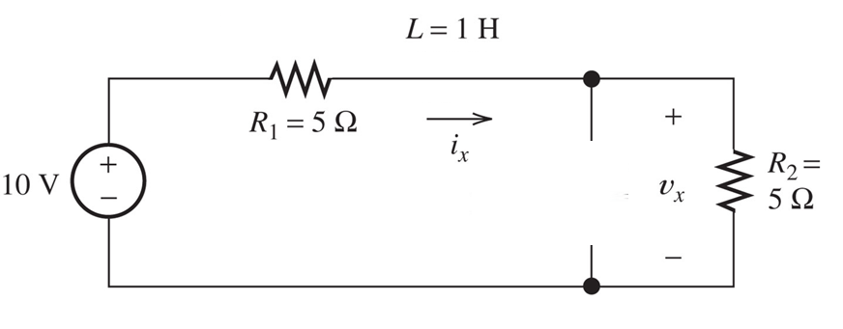
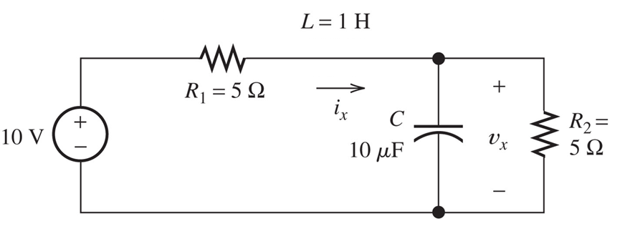

week c: dc steady state
Equivalent circuit at $t=∞$
i_{x} = V / (R₁ + R₂) = 1 A
v_{x} = R₂ / (R₁ + R₂) x V = 5 V (voltage division)

Slide 6
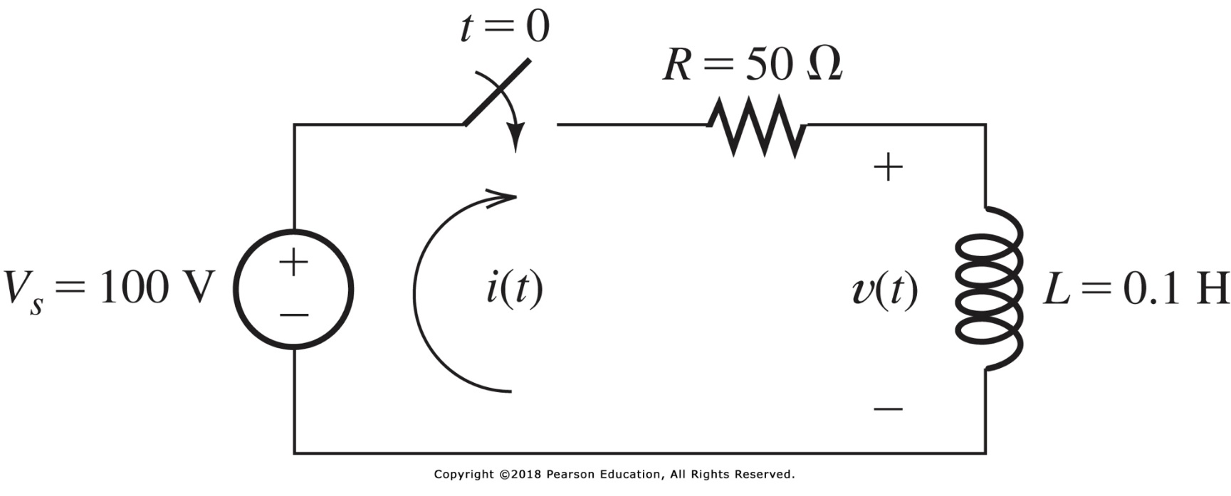
RL circuits
Find expressions for i(t) and v(t) for t > 0
probably a differential equation?

Slide 7
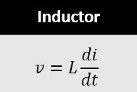
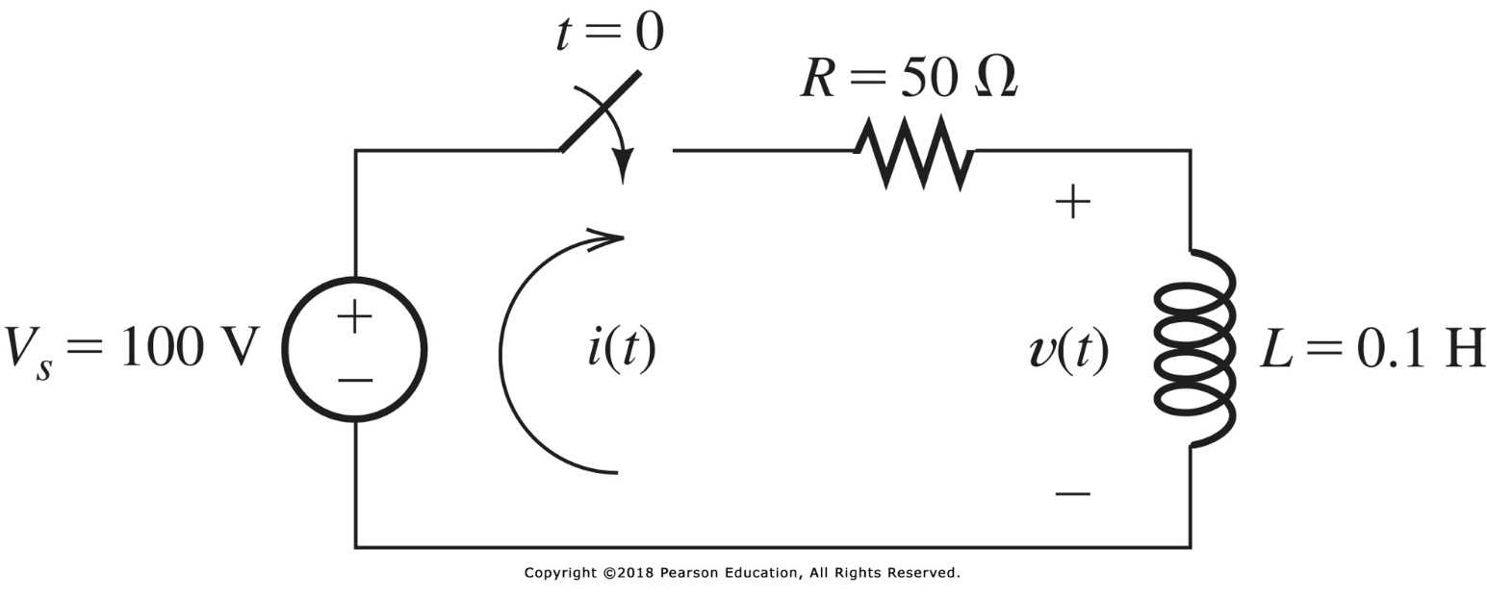
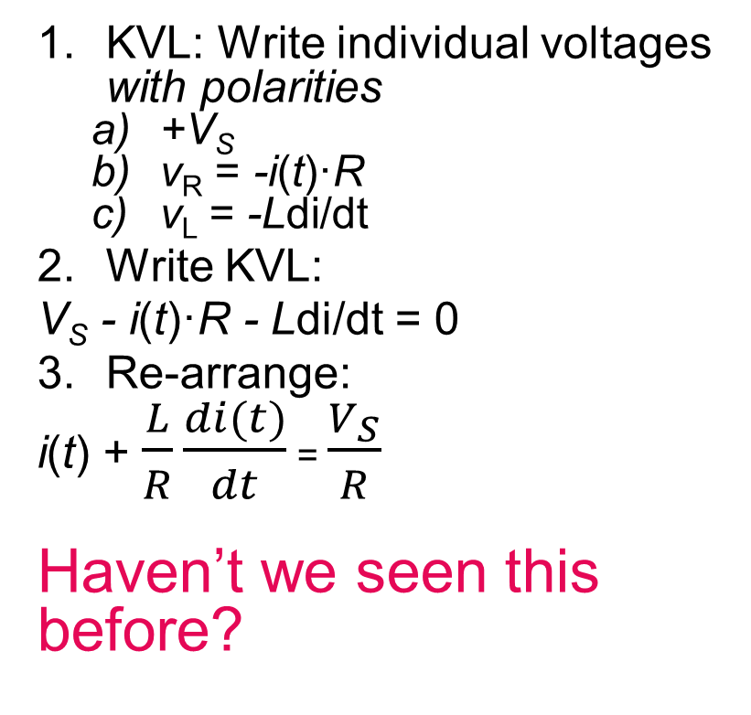
RL circuits - using KVL
KVL: Write individual voltages with polarities
+V_{S}
v_{R} = -i(t)·R
v_{L} = -Ldi/dt
Write KVL:
V_{S} - i(t)·R - Ldi/dt = 0
Re-arrange:
i(t) + $\frac{L}{R}\frac{di(t)}{dt}$ = $\frac{V_{S}}{R}$
Haven’t we seen this before?

Slide 8
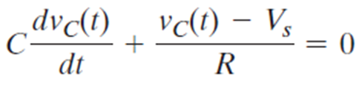

RL circuits - using KVL
i(t) + $\frac{L}{R}\frac{di(t)}{dt}$ = $\frac{V_{S}}{R}$
Remember week B, charging a capacitor (and KCL):
Educated guess i=K₁+K₂e^{st}

Slide 9
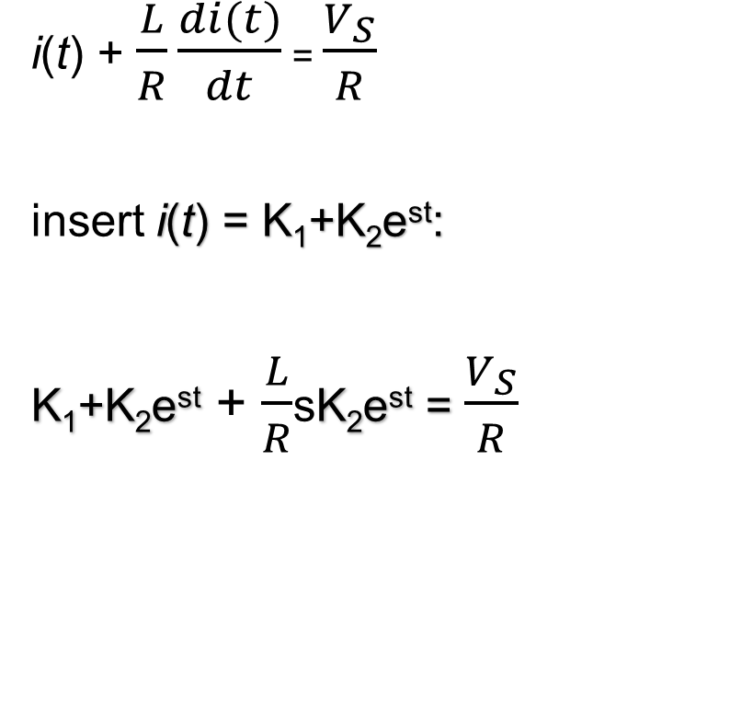
RL circuits - using KVL
i(t) + $\frac{L}{R}\frac{di(t)}{dt}$ = $\frac{V_{S}}{R}$
insert i(t) = K₁+K₂e^{st}:
K₁+K₂e^{st} + $\frac{L}{R}$sK₂e^{st} = $\frac{V_{S}}{R}$

Slide 10

RL circuits - using KVL
K₁+K₂e^{st} + $\frac{L}{R}$sK₂e^{st} = $\frac{V_{S}}{R}$

Slide 11
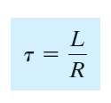
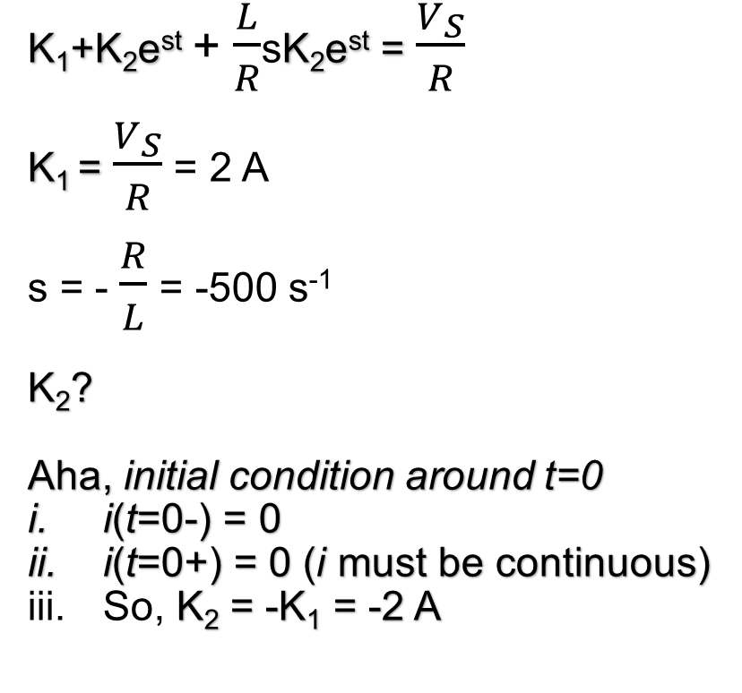
RL circuits - using KVL
K₁+K₂e^{st} + $\frac{L}{R}$sK₂e^{st} = $\frac{V_{S}}{R}$
K₁ = $\frac{V_{S}}{R}$ = 2 A
s = - $\frac{R}{L}$ = -500 s⁻¹
K₂?
Aha, initial condition around t=0
i(t=0-) = 0
i(t=0+) = 0 (i must be continuous)
So, K₂ = -K₁ = -2 A
i(t) = K₁+K₂e^{st}
i(t) = 2-2e^{-500t} A

Slide 12
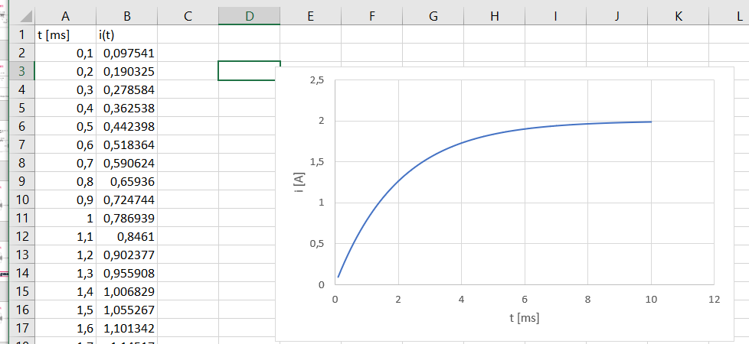
i(t) = 2-2e^{-500t} A

Slide 13
RL circuits - using KVL
Final step: find v(t)
so (how’s your Math?)
0.1*d(2-2e^{-500t})/dt
v(t) = 100e^{-500t} V
i(t) = 2-2e^{-500t} A

Slide 14
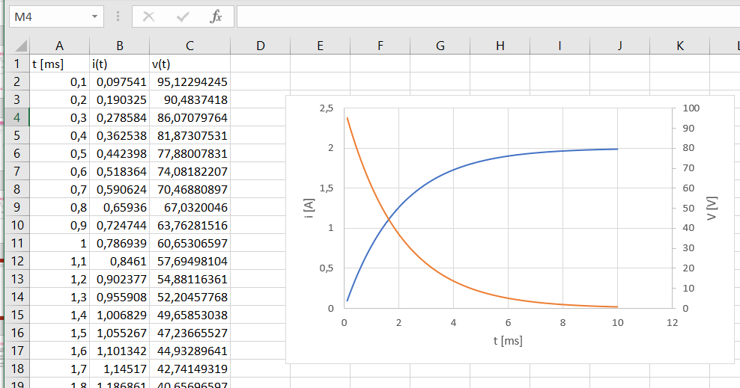

Slide 15
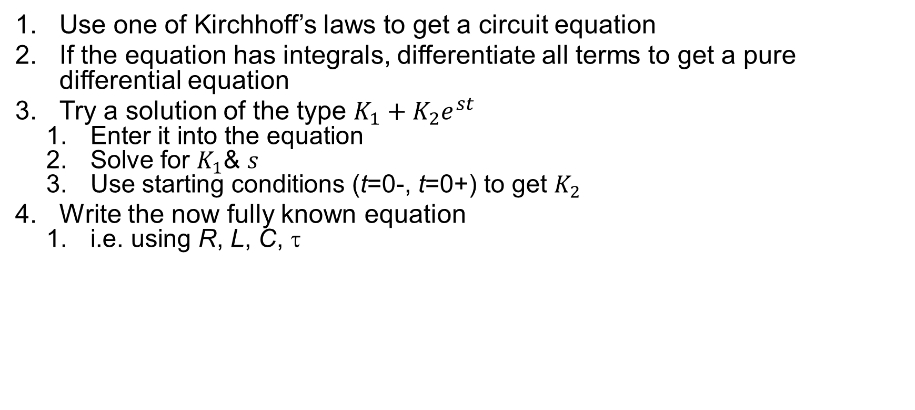
Recipe for simple circuits (RC & RL)
Use one of Kirchhoff’s laws to get a circuit equation
If the equation has integrals, differentiate all terms to get a pure differential equation
Try a solution of the type $K_{1}+K_{2}e^{st}$
Enter it into the equation
Solve for $K_{1}$& $s$
Use starting conditions (t=0-, t=0+) to get $K_{2}$
Write the now fully known equation
i.e. using R, L, C, τ

Slide 16
RL circuits – now via KcL
Find expressions for i(t) and v(t) for t > 0
surely another differential equation

Slide 17


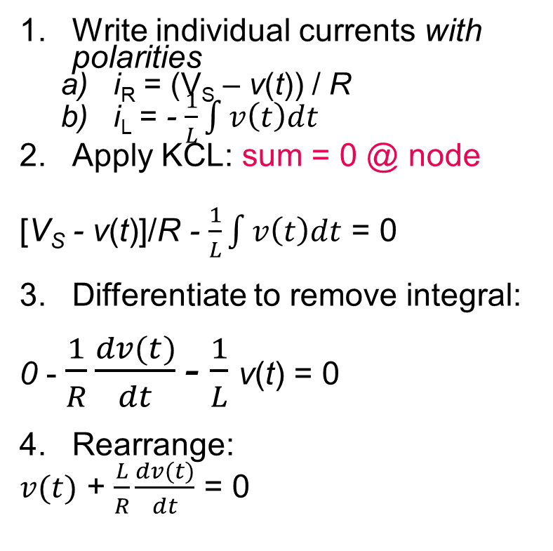
RL circuits – now via KcL
Write individual currents with polarities
i_{R} = (V_{S} – v(t)) / R
i_{L} = - $\frac{1}{L}\int{v\left(t\right)dt}$
Apply KCL: sum = 0 @ node
[V_{S} - v(t)]/R - $\frac{1}{L}\int{v\left(t\right)dt}$ = 0
Differentiate to remove integral:
0 - $\frac{1}{R}\frac{dv(t)}{dt}$ - $\frac{1}{L}$v(t) = 0
Rearrange:
$v(t)$ + $\frac{L}{R}\frac{dv(t)}{dt}$ = 0

Slide 18
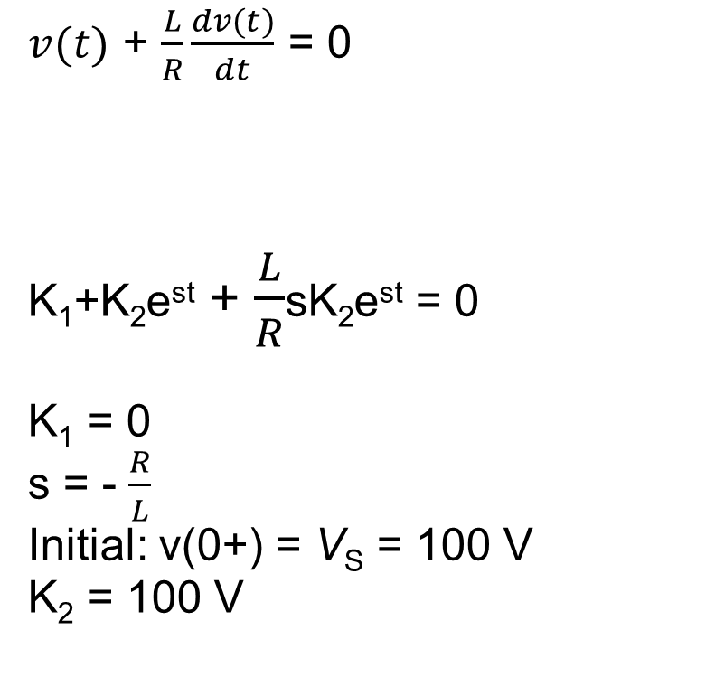
RL circuits – now via KcL
$v(t)$ + $\frac{L}{R}\frac{dv(t)}{dt}$ = 0
K₁+K₂e^{st} + $\frac{L}{R}$sK₂e^{st} = 0
K₁ = 0
s = - $\frac{R}{L}$
Initial: v(0+) = V_{S} = 100 V
K₂ = 100 V
Try v=K₁+K₂e^{st}
v(t) = 100e^{-500t} V

Slide 19
RL circuits – now via KcL
Final step: find i(t)
i(t) is the same everywhere, so choose R to get it using Ohm’s law
i(t) = (Vs – v(t)) / R
= (100 - 100e^{-500t}) / 50
i(t) = 2 - 2e^{-500t} A
v(t) = 100e^{-500t} V

Slide 20
RL circuits – via DC steady state
will follow later

Slide 21
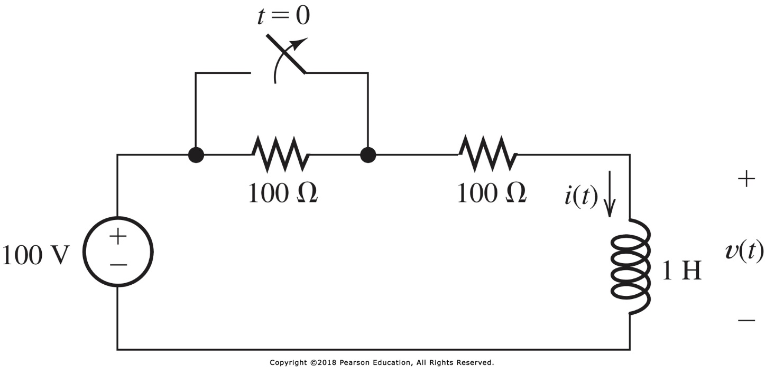
Exercise
Find i(t) and v(t) for t>0

Slide 22
problems for the exercises session
P4.31
P4.33
P4.34
P4.37
P4.39
P4.42

